Slide 1
SMS Editor - Technical Design

Slide 2
MicroService Approach 2
SMSE UI will be created in KOKO Core and backend will be created as Micro service
SMS Engine will be a microservice so other platform can still send send sms through this service
Future Vision:
KOKO Admin will be a separate UI Admin with no backend
Single Backend will be converted to micro services that will be communicating with Admin and in between
Pros | Cons
KOKO core UI will be used to create components of SMSE | Release dependency for the UI as it is in the KOKO Core Monolithic App
Send sms engine will not depend on the KOKO Core | Future vision of creating KOKO Core as a micro-service will stuck in roadmap. And a whole big sprint will be needed to convert it into microservice. Not a progressive Approach
Load sharing will be independent and continuous deployment for backend
No Need to create separate UI and its deployment process
KOKO Core with SMSE
SMSE DB
SMSE Service
KOKO Core DB

Slide 3
Approach 2 Enhanced Future Vision
KOKO Core Micro Services 1
DB 1
KC Common UI
Different Pages (KP)
KOKO Core Micro Services 2
DB 2
Different Pages (SMSE)
SMSE Micro Services 3
DB 3

Slide 4
SMSE Overview
Separate Backend Microservice will be created for SMSE
SMSE UI will resides in KOKO Core as Vuejs Single Page Application UI
For User Management,
Activity Log
KOKO Core UI
Send request with template_id and dynamic variables and sms details
SMSE UI
KOKO Core Backend
Admin can access dashboard to edit and view message templates from KOKOCore
SMSE Backend
(Responsible to send sms/serve UI)
Other Services(AWS, Grafana)
Message send to end user
Send request with basic sms details like recipient number, content and sender Id
Things to be implements in SMSE

Slide 5
SMSE Overview
Development work of SMSE is divided into three parts
SMSE Web - Admin can view/edit the predefined sms templates
SMSE Backend - Backend to support web and send sms to end users
KOKO Core changes - Add trigger in KOKO Core to call SMSE project

Slide 6

SMSE Web
Following Components will be created for SMSE Web in this version
Home Page
Search SMS
Edit SMS
Activity Log View

Slide 7
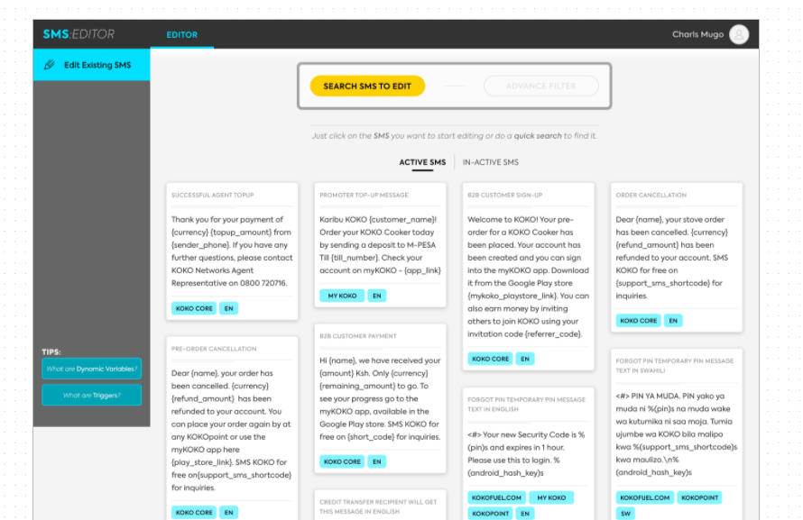
Home Page & Search SMS
List view for active/inactive SMS with 20 SMSes limit, on load more it will get more sms template
Search SMS View with functionality
Advance Search SMS View with platform and language
Dynamic Variable Dialog will contain all the dynamic variable with basic description and with search functionality
Triggers Dialog will contain all the triggers with basic description and with search functionality
Edit view page will be open on click on any sms template

Slide 8
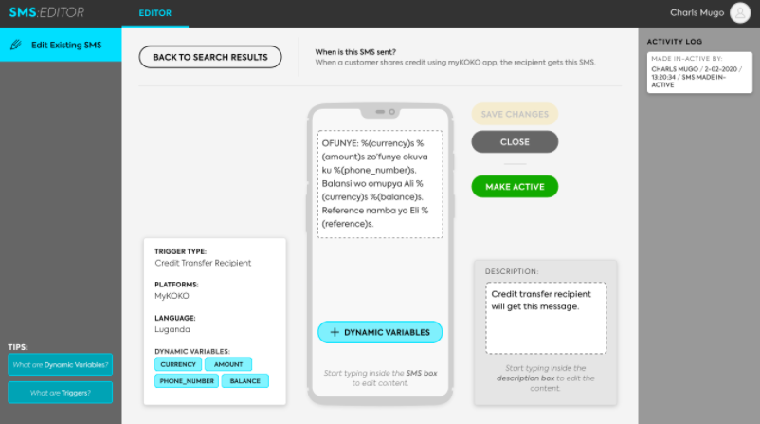
Edit View Page
Basic Edit view page details like, SMS Template name, description, platform, language, dynamic variable used, content
User can change the active/inactive status
User can change the language from list of language
User can change the description
User can change the content as well as add dynamic variable from list of variables
On save create a activity log
Note: User with edit permission can only edit else all
all the fields will be readonly for read only user

Slide 9
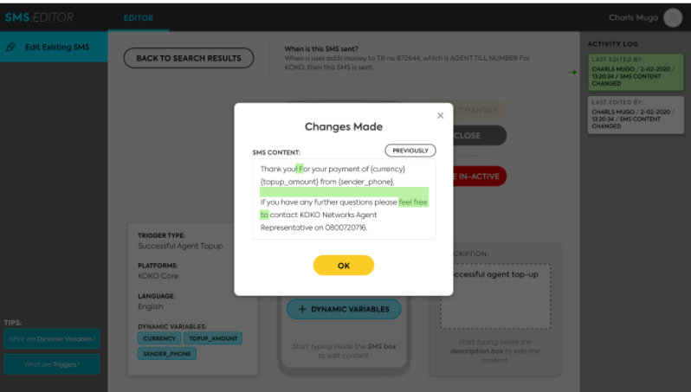
Activity Log View
Activity log history view on right side
On every change of SMS template activity log will be added with the change
On click of activity log dailog will be open with more details

Slide 10
SMSE Backend
Tables - SMS
Name: sms_template
Columns
koko_core_name*
smse_name*
description*
message*
sms_language_id
is_active*
sms_provider_id
Name: sms_template_platform_mapping
Columns
sms_template_id*
sms_platform_id*
Name: sms_dynamic_variable
Columns
name*
description*
Name: sms_template_dynamic_variables
Columns
sms_template_id*
sms_dynamic_variable_id*
is_active*
Name: sms_platform
Columns
name*
Name: sms_language
Columns
name*
Tables - sms history
Tables - sms_provider
Name: sms_history
Columns
sender*
receiver*
user_id
type*(incoming/outgoing)
external_id*(third party id)
message*
status*
template_id
system
Name: sms_provider
Columns
sender*
is_default*
provider_name*
username*
password*

Slide 11
SMSE Backend
APIs
/send/sms
Send normal sms with parameter
sender(optional)
receiver(list)
message
user_id(optional)
source(text)
/send/sms/template
Send sms with template and dynamic variable
receiver(list)
user_id
dynamic_variables
key-value
template_name -> “topup”
source(text)
/receive/sms/africastalking
Receive SMS
from
linkId
to
text
date
id
/user/sms/<id>(GET)
[list of sms with status including incoming and outgoing] - Get all message using UserId

Slide 12
SMSE Backend
On Receive sms if its not a modem message create a zendesk ticket
If modem message received forward message KOKO that will update fuel point status with the message received
Bulk move the seeder data from events table of KOKO Core to sms history table of SMSE backend
KOKO Core List SMS view page will be fetched from SMSE backend API

Slide 13
KOKO Core Changes
In every send sms instances call the /send/sms/template with the relevant template_id
/send/sms/template
Send sms with template and dynamic variable
sender
receiver(list)
dynamic_variables
key-value
template_id
source(text)
Remove /receive/sms API
Add kp/receive/sms/modem API
sender
message
Get user details from phone number for zendesk ticket creation

Slide 14
SMSE updated Approach(5/08/2020)
Sending SMS synchronously
1. After the SMS API is called, the response is logged in history table and KC gets the response from Notification Engine(SMSE microservice)
2. Features like Promotion expect a response from the notification engine when the sms is sent.
Sending SMS asynchronously
When the Notification engine API for sending the SMS is called, it will call the Sms Provider API.
When the SMS provider API is invoked, a callback function will be called which will log the SMS response in the smse history table
Step 2 happens asynchronously such that, when the SMS Provider API is being executed, the response from SMSE Service API would have been already received by KC thus not resulting into Timeout error for bulk sms.

Slide 15
SMSE updated Approach(5/08/2020) - Synchronous SMS (used in promotions)
KOKOCore
1
2
SMSE Service
Africastalking
4
3
SMSE service update db
KC invokes the SMSE service API
SMSE service then calls the africastalking API
Waits for Africastalking api response and then logs the response in the SMS History Table
Then SMSE Service sends the response back to the KC with success message.

Slide 16
SMSE updated Approach(5/08/2020) - Asynchronous SMS (general use)
1
Buffer for outbound SMS
KOKOCore
SMSE Service
2
Africastalking
3
4
SMSE service updates db
KC invokes the SMSE service API to send an SMS
SMSE sends messages in its own via the africastalking API in a new thread (asynchronous / non blocking).
SMSE service returns to KOKO core immediately
Africastalking sends the SMS to the recipient number and returns to SMSE when the message is sent via a callback function specified (in the thread spawned in step 2). SMSE then logs the sms in the SMS history table at this point.

Slide 17
SMSE updated Approach(5/08/2020)
Changes in the SMSE
APIs
/send/sms
Send normal sms with parameter
sender(optional)
receiver(list)
message
user_id(optional)
source(text)
synchronous(Boolean, default=False)
-> Add 2 functions to send sms to synchronously and asynchronously.
Changes in the KC
Send sms for Promotion with synchronous flag as True.
Add synchronous flag to the request payload, default as false.
Do for both server and workers.

Slide 18
SMS configuration in Koko Core(10/02/2021)
Problem Statement
In today’s date when the QA or Dev team has to test the sms feature, the credentials have to updated in the database and re-deploy the server stack for the configuration to reflect.
Following are the issues -
It’s time consuming.
Keep a record of sms config(Sandbox or live credentials) used by Notification engine.

Slide 19
SMS configuration in Koko Core
Solution
Add a Toggle button in the KOKO Core to enable SMS live credentials
Create an API in Notification Engine which would set the default credential(Africastalking sandbox or Live SMS ) in the Notification Engine database.
Have a specific permission for toggling the sms configurations.

Slide 20
SMS configuration in Koko Core
3. Navigate to SMS Configuration
1 .Log In to KOKO Admin
Koko Admin
2. Navigate to SMS Editor
SMS Editor
Toggle the Live SMS credentials
4. Invoke the API when toggle button for SMS Live Credential is set to true
Notification engine Database
Notification engine
5. Based on the toggle button value, set the default sms credential in the NE database

Slide 21
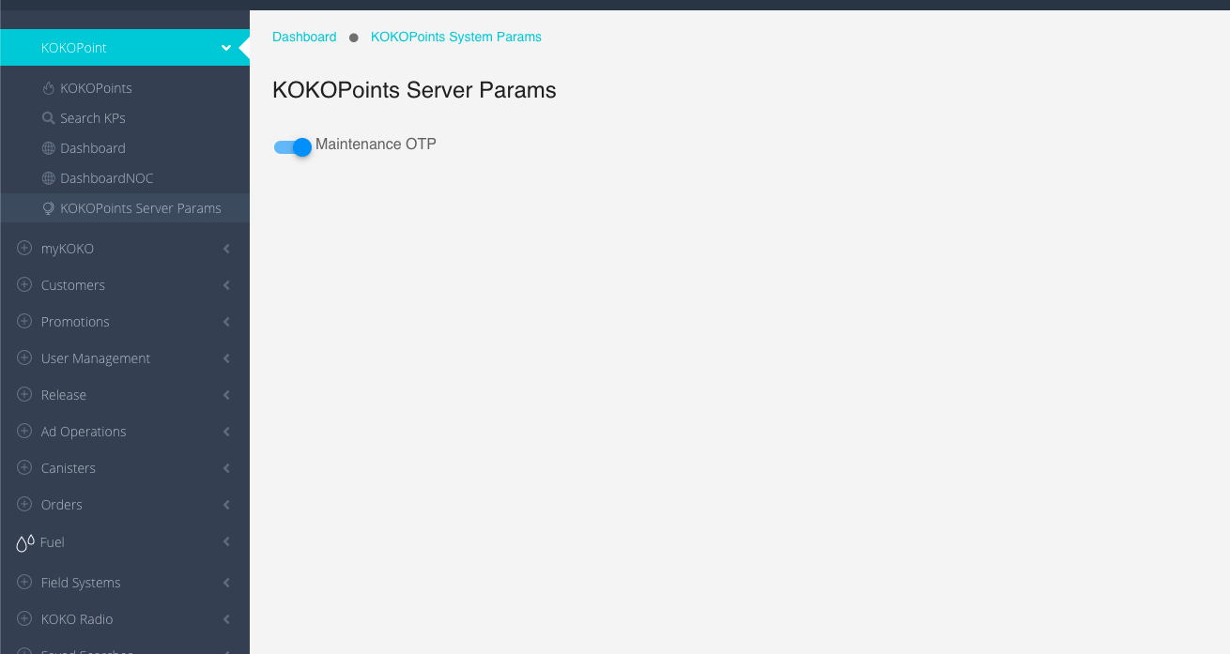
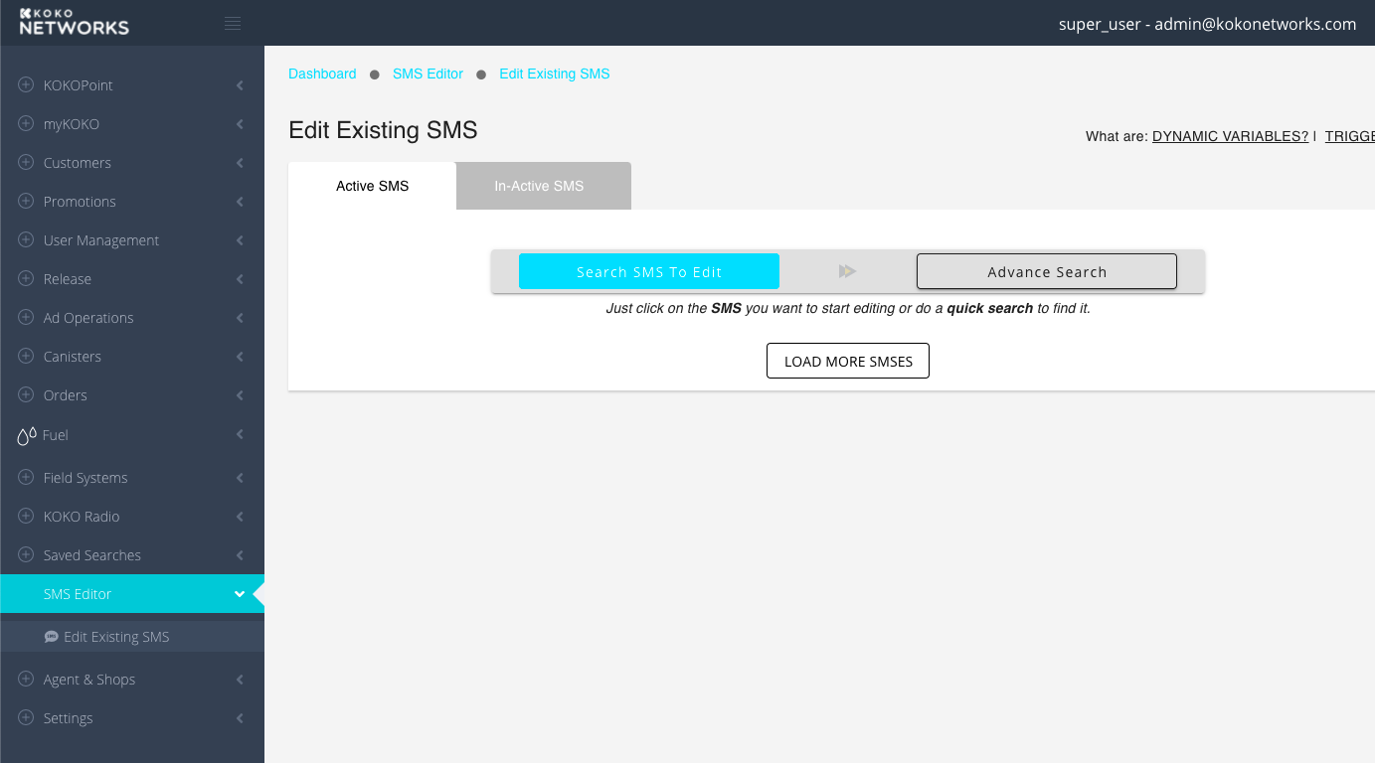
SMS configuration in Koko Core
Changes required
Implement the same UI for SMS Configuration
2. Have the configuration under SMS Editor

Slide 22
SMS configuration in Koko Core
Changes required
Create an API in Notification engine to set the default sms provider credential.
2. Create a permission in the Koko Admin,
3. Add a new section under sms editor for sms configuration in Koko admin.

Slide 23
Freshdesk & Zendesk Setting
Problem Statement
The Freshdesk and Zendesk ticket is created in the Notification Engine microservice for the SMS received at KOKO Core end but for the CALLS it gets created in KOKO Core. So to keep it consistent, the creation of the tickets for the Calls received will have to be migrated to the Notification Engine service.

Slide 24
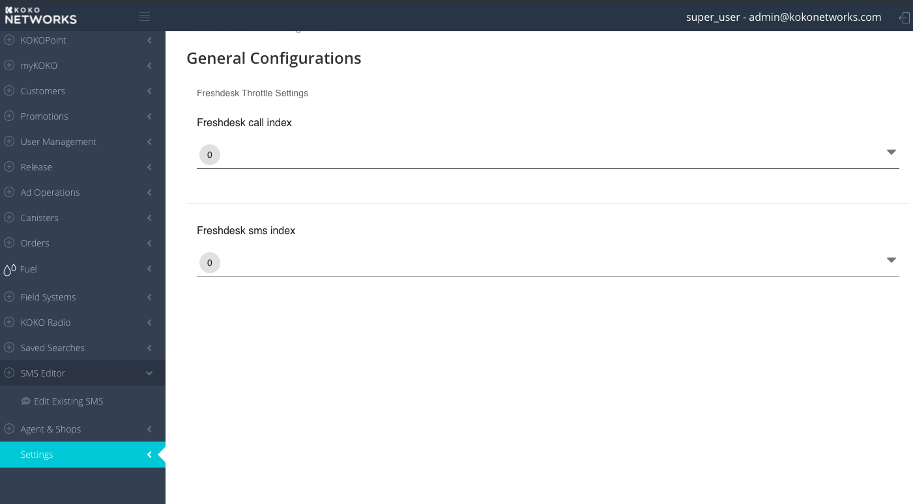
Freshdesk & Zendesk Setting
Changes required
Migrate code for creation of Zendesk and Freshdesk ticket for calls from KOKO Core to Notification Engine
2. Move the Settings panel in KOKO Admin under the SMS Editor Panel since the settings belongs to the Notification Engine service

Slide 25
Thank you

